Slide 1

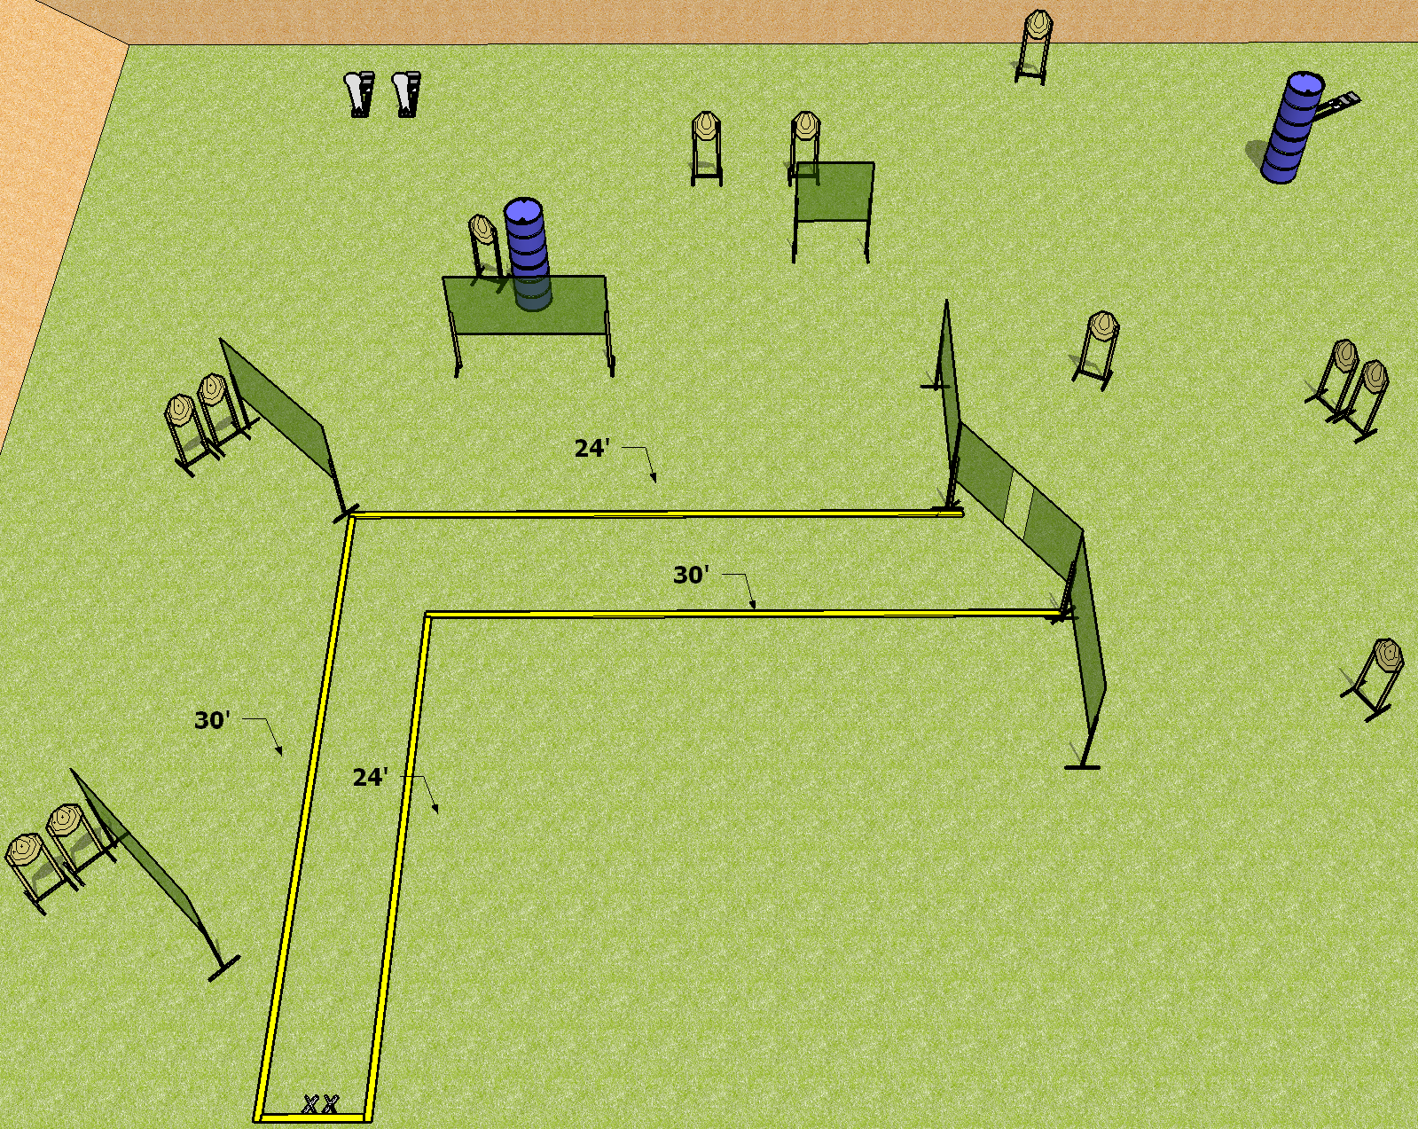
 | Dothan Practical Shooters – USPSA Match All Open? Course Designer : Drew Coleman Bay: A2
Round Count 27 rounds 12 IPSC 3 colt poppers
Equipment List 14 wall feet

Slide 2
All Open?
Written Stage Briefing
Scoring: Comstock Rounds: 27 rounds
Targets: 12 IPSC, 3 steel
Handgun start position: Heels on X’s, wrists below belt. Handgun is loaded and holstered.
PCC start position: heels on X’s, stock on belt. Loaded carbine is held with both hands, safety on.
Stage Procedure: on the audible start signal, engage targets as they become available from within the shooting area.

